Slide 1
Clustering
Part B: kmeans clustering

Slide 2
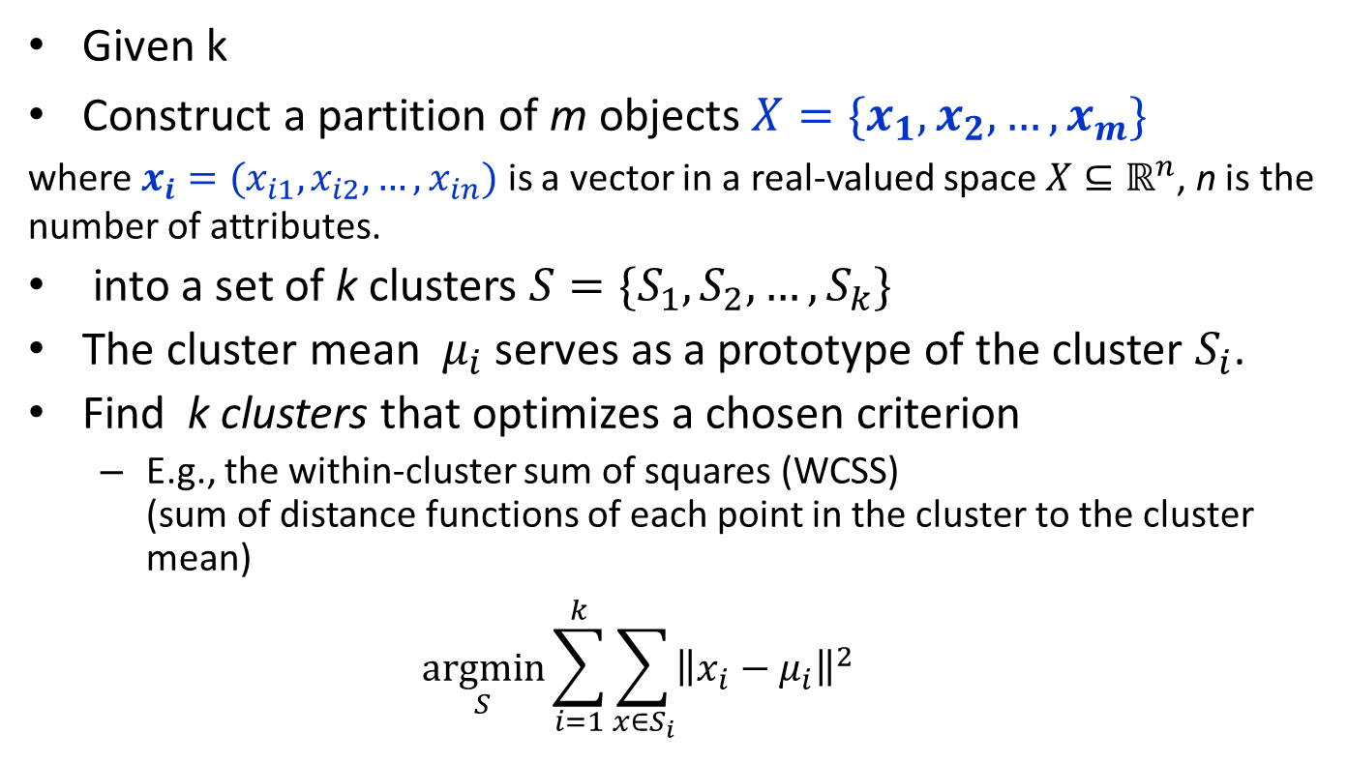
Partitioning Algorithms
Given k
Construct a partition of m objects $X=\{x_{1},x_{2},…,x_{m}\}$
where $x_{i}=(x_{i1},x_{i2},…,x_{in})$ is a vector in a real-valued space $X⊆ℝ^{n}$, n is the number of attributes.
into a set of k clusters $S=\{S_{1},S_{2},…,S_{k}\}$
The cluster mean $μ_{i}$ serves as a prototype of the cluster $S_{i}$.
Find k clusters that optimizes a chosen criterion
E.g., the within-cluster sum of squares (WCSS) (sum of distance functions of each point in the cluster to the cluster mean)
$$\underset{S}{argmin}{\sum_{i=1}^{k}{\sum_{x∈S_{i}}{{\left\|x_{i}−μ_{i}\right\|}^{2}}}}$$
Heuristic method: k-means (MacQueen, 1967)

Slide 3
K-means algorithm
Given k
Randomly choose k data points (seeds) to be the initial cluster centres
Assign each data point to the closest cluster centre
Re-compute the cluster centres using the current cluster memberships.
If a convergence criterion is not met, go to 2.

Slide 4
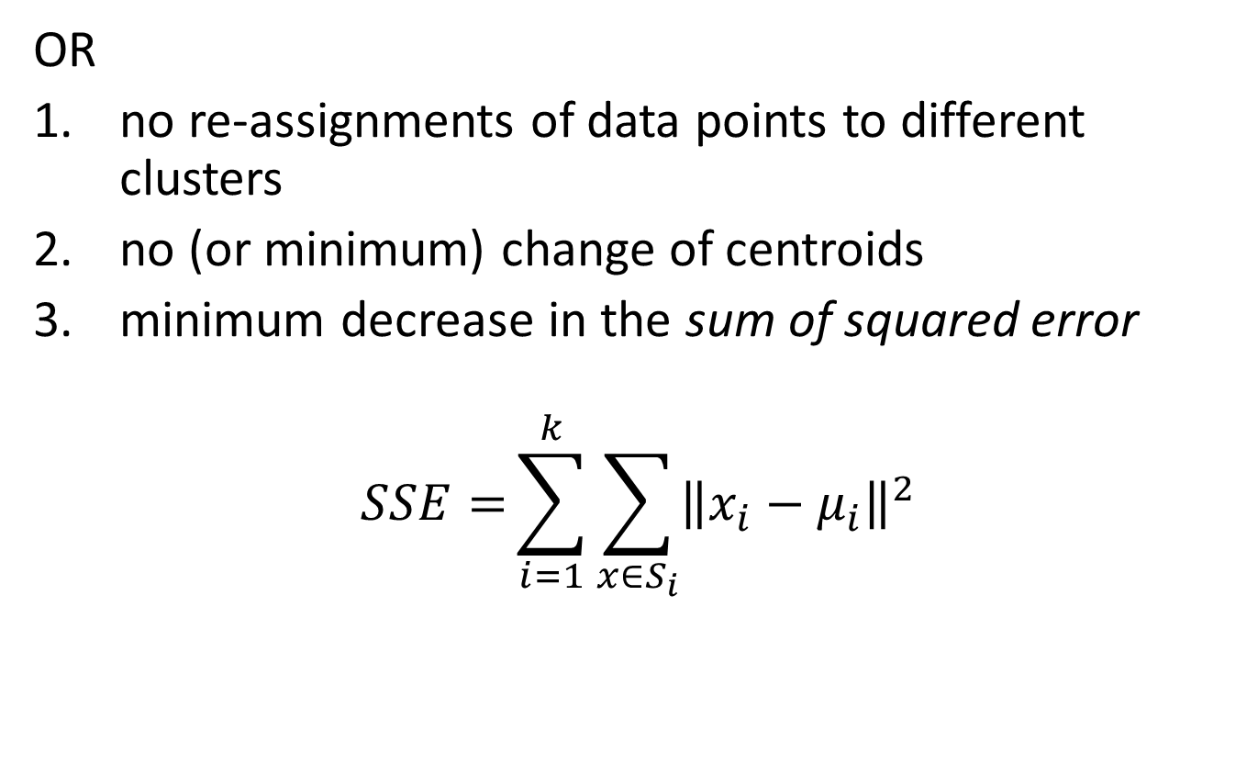
Stopping/convergence criterion
OR
no re-assignments of data points to different clusters
no (or minimum) change of centroids
minimum decrease in the sum of squared error
$$SSE={\sum_{i=1}^{k}{\sum_{x∈S_{i}}{{\left\|x_{i}−μ_{i}\right\|}^{2}}}}$$

Slide 5
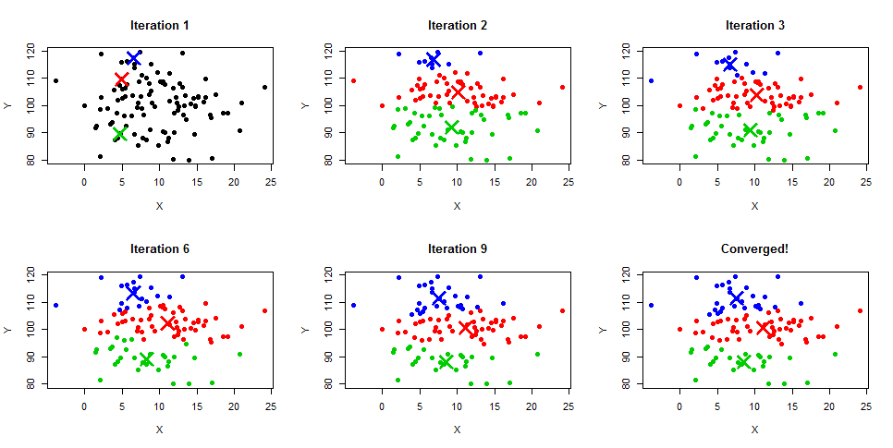
Kmeans illustrated

Slide 6
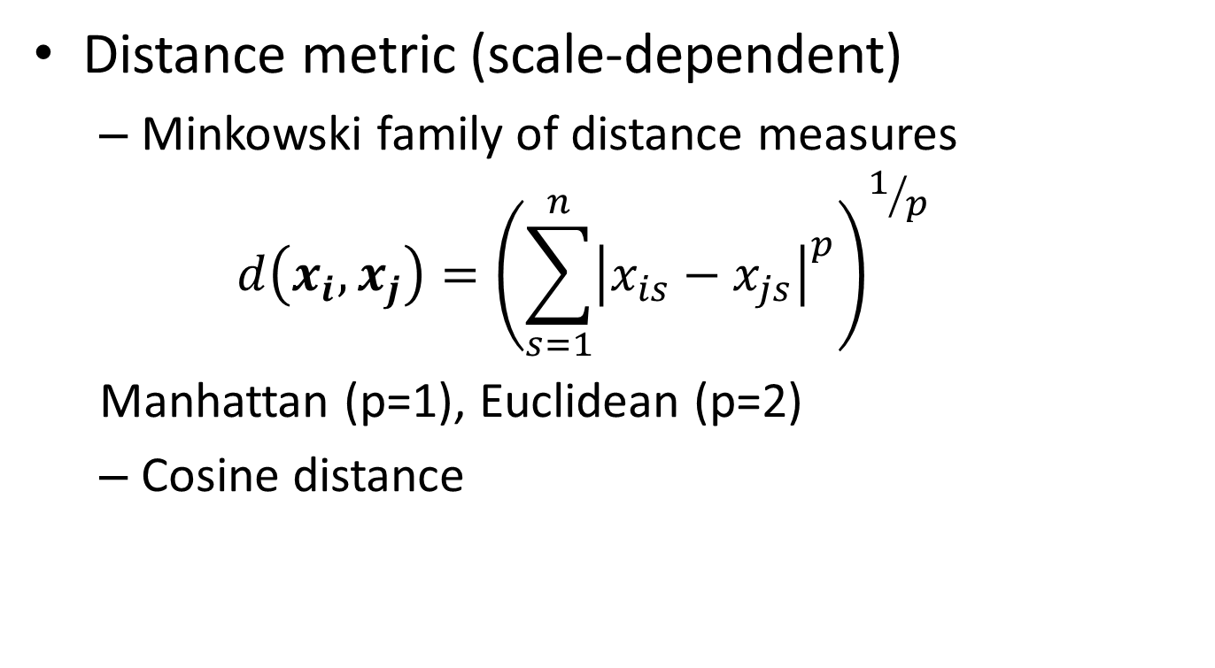
Similarity / Distance measures
Distance metric (scale-dependent)
Minkowski family of distance measures
$$d\left(x_{i},x_{j}\right)={\left(\sum_{s=1}^{n}{{\left|x_{is}−x_{js}\right|}^{p}}\right)}^{1/p}$$
Manhattan (p=1), Euclidean (p=2)
Cosine distance

Slide 7
Thank You

